Slide 1
LLM-Powered Agentic Dashboard for Business-Intelligence
Shyam Sundar K SRN: R22MSA55 | Date: 27/06/2026
M.Sc. in
Artificial Intelligence
Capstone Project Presentation
Year: I

Slide 2
01 Introduction
Background | Current status | Why this study
07 Software Design
High Level | Low Level Design Diagrams
02 Literature Review
Seminal works | Summary | Research Gap
08 Implementation
Demo | Application | Use cases
03 Problem Statement
Technical | Functional Problem
09 Testing,Validation and Results
Test Results | Learnings
Agenda
04 Project Objectives
Primary & Secondary Objectives | Expected Outcome
10 Suggestions and Conclusions
Insights | Next Step | Future Scope
05 Project Methodology
Conceptual Framework | Research Design
11 Annexure
References | Publications | Plagiarism Score
06 Resource Specification
Software | Hardware

Slide 3
Introduction
Background | Current Status | Why This Topic?
Organizations generate large volumes of business data Traditional BI tools require manual dashboard design Analytics often depends on skilled analysts | LLMs can understand natural language queries AI-assisted analytics is rapidly evolving Most BI tools still lack seamless AI-driven dashboard generation | Reduce time from question to insight Enable self-service analytics for non-technical users Automate visualization and insight generation using Agentic AI

Slide 4
Literature Review
No. | Title | Author and Year | Journal | Description | Insights | Research Gaps/Comments
1 | AI4VIS: Survey on Artificial Intelligence Approaches for Data Visualization | Wu et al. (2021) | IEEE TVCG | Comprehensive survey of AI techniques for data visualization, chart recommendation, and insight discovery. | Demonstrates the growing role of AI in visualization automation. | Does not provide an end-to-end natural language dashboard generation system.
2 | MultiVision: Designing Analytical Dashboards with Deep Learning Based Recommendation | Wu et al. (2021) | IEEE TVCG | Recommends dashboard layouts using deep learning and visualization recommendation techniques. | Improves automated dashboard design. | Limited to dashboard recommendation; lacks analytics and workflow automation.
3 | Explainable Artificial Intelligence: A Survey of Needs, Techniques, Applications, and Future Direction | Mersha et al. (2024) | Neurocomputing | Reviews Explainable AI methods and interpretable AI systems. | Highlights the importance of generating human-understandable insights. | Does not integrate explainability with interactive BI dashboards.
4 | nvAgent: Automated Data Visualization from Natural Language via Collaborative Agent Workflow | Ouyang et al. (2025) | ACL | Uses collaborative AI agents to convert natural language into data visualizations. | Shows the effectiveness of Agentic AI for visualization generation. | Focuses on visualization generation rather than a complete BI platform with preprocessing, validation, and dashboards.

Slide 5
Problem Statement
Businesses generate large amounts of data every day, but turning that data into meaningful insights still requires significant manual effort and technical expertise. Although AI can understand natural language, most business intelligence tools cannot automatically convert user questions into interactive dashboards with relevant visualizations and business insights, making data analysis slower and less accessible to non-technical users.
Key Challenges
Manual data preparation and dashboard creation
Dependence on technical expertise for data analysis
Time-consuming analytical workflow
Limited support for natural language-driven business intelligence

Slide 6
Project Objectives
Design an intelligent workflow for natural language-driven business data analysis and visualization.
Develop an interactive dashboard for dynamic data exploration and automated visualization generation.
Evaluate the accuracy, reliability, and effectiveness of generated visualizations and business insights.
Deploy an accessible business intelligence solution for intuitive decision support and reporting.

Slide 7
Project Methodology
Methodology: Team Data Science Process (TDSP)
Research Design
Research Type: Design and Development Research
System: LLM-Powered Agentic Dashboard
Dataset: Structured Sales Transaction Dataset
Architecture: LangGraph + Dash + Streamlit
Evaluation: Functional, Performance, and End-to-End Validation
Workflow:
Data Preparation
LLM Agentic Workflow
Deployment
Validation
Data Acquisition & Understanding
Business Understanding

Slide 8
Resource Specifications
Software | Hardware | Other Resources
Python 3.9+ | Intel Core i5/i7 | Sales Transaction Dataset (CSV)
Pandas & NumPy | 8+ GB RAM | OpenAI-Compatible API
Plotly & Dash | 256 GB SSD | Stable Internet Connection
Streamlit | Windows 10/11 | Environment Variables (.env)
LangGraph
Key Highlights
Open-source Python ecosystem
Standard laptop hardware (No GPU required)
Modular and scalable architecture
Cloud-based LLM integration

Slide 9
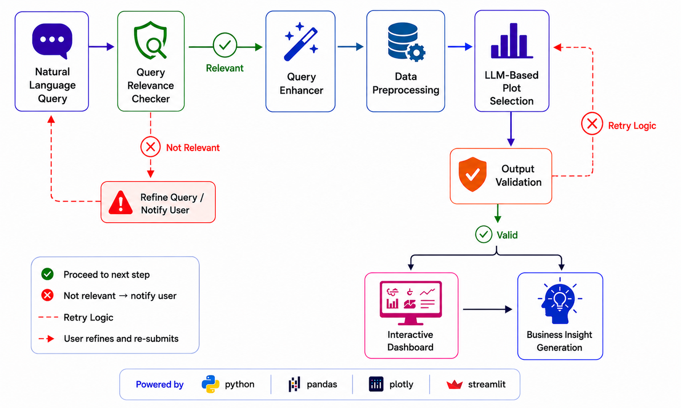
Software Design
Design Highlights
Modular multi-agent architecture
Validation with automatic retry logic
Dynamic dashboard generation
Interactive visualizations with AI-generated insights

Slide 10
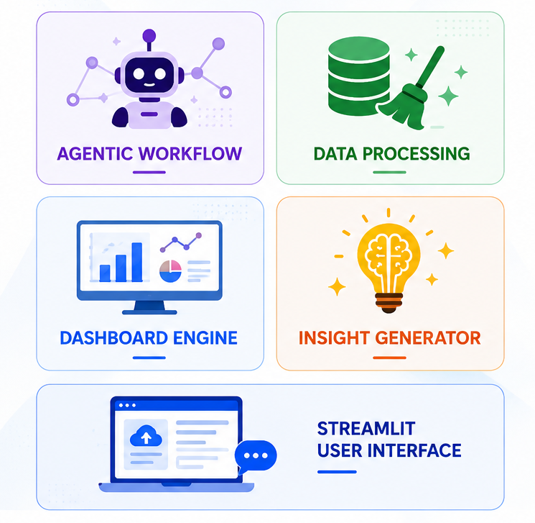
Implementation
Implementation Deliverables
Agentic Workflow
Developed a LangGraph-based multi-agent workflow for intelligent query processing.
Data Processing
Implemented automated data cleaning, transformation, and preprocessing.
Dashboard Engine
Built a configuration-driven engine for dynamic dashboard generation.
Insight Generation
Integrated LLM-powered business insight generation for visualizations.
User Interface
Developed a Streamlit interface for dataset upload and natural language interaction.

Slide 11
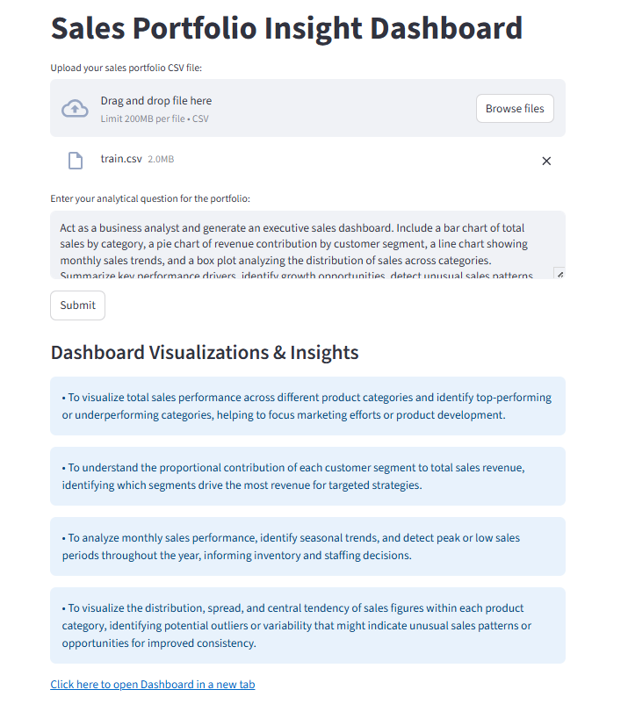
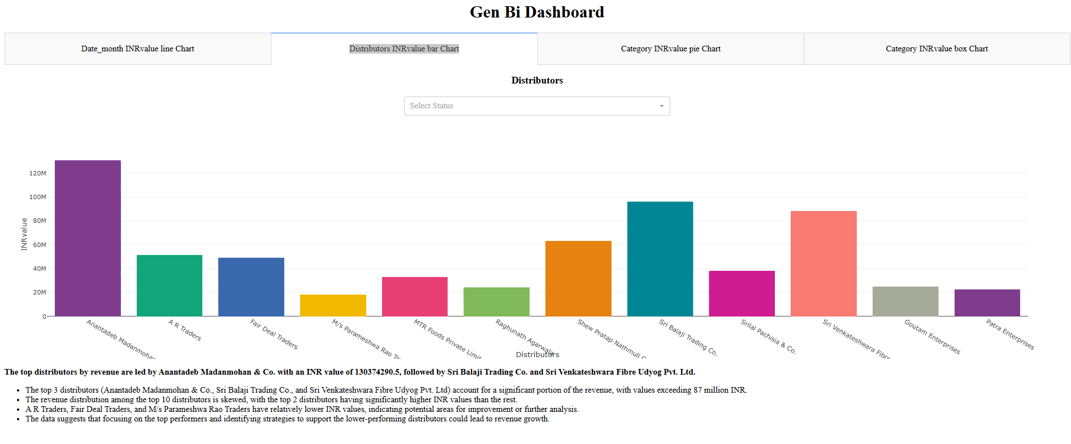
Demo
Interactive Dashboard with AI-Generated Visualizations and Business Insights
Dataset Upload & Query Input Interface

Slide 12
Demo
https://www.youtube.com/watch?v=j-BumloXP8E

Slide 13
Testing Validation, and Results
Testing & Validation
Test Scenario | Expected Outcome | Status
Dataset Upload | Dataset loaded successfully | ✅ Pass
Natural Language Query | Query processed correctly | ✅ Pass
Dashboard Generation | Appropriate visualizations generated | ✅ Pass
Interactive Filtering | Dashboard updates dynamically | ✅ Pass
Insight Generation | Relevant business insights produced | ✅ Pass
Key Results
Successfully generated interactive dashboards from natural language queries.
Automated visualization selection based on dataset characteristics.
AI-generated contextual business insights for decision support.
Validation and retry mechanism improved output reliability.
Most dashboard responses were generated within one minute.

Slide 14
Conclusion and Future Scope
Conclusion
Demonstrated the feasibility of integrating LLMs with Business Intelligence for automated analytics.
Simplified the analytics workflow by reducing manual dashboard configuration.
Enabled intuitive data exploration through natural language interaction.
Established a scalable foundation for intelligent, self-service business intelligence.
Future Scope
Integrate real-time and database-driven data sources.
Expand support for advanced visualizations and analytical techniques.
Enable multi-user collaboration with role-based access control.
Support multiple LLM providers and enterprise deployment.

Slide 15
References
Bibliography | Webliography
A. Wu et al., “AI4VIS: Survey on Artificial Intelligence Approaches for Data Visualization.” [Online]. Available: http://csrankings.org/
Y. Luo, N. Tang, G. Li, J. Tang, C. Chai, and X. Qin, “Natural Language to Visualization by Neural Machine Translation.” [Online]. Available: https://github.com/Thanksyy/ncNet
M. Mersha, K. Lam, J. Wood, A. AlShami, and J. Kalita, “Explainable Artificial Intelligence: A Survey of Needs, Techniques, Applications, and Future Direction,” Jan. 2025, doi: 10.1016/j.neucom.2024.128111.
N. Bikakis, “Big Data Visualization Tools,” in Encyclopedia of Big Data Technologies, Springer International Publishing, 2022, pp. 1–8. doi: 10.1007/978-3-319-63962-8_109-2.
A. Wu et al., “MultiVision: Designing Analytical Dashboards with Deep Learning Based Recommendation,” Jul. 2021, [Online]. Available: http://arxiv.org/abs/2107.07823
C. North, “Toward measuring visualization insight,” IEEE Comput. Graph. Appl., vol. 26, no. 3, pp. 6–9, May 2006, doi: 10.1109/MCG.2006.70.

Slide 16
References
Bibliography | Webliography
LangChain, “LangGraph: Build Stateful Multi-Actor Applications with LLMs,” https://langchain-ai.github.io/langgraph/.
G. Ouyang et al., “NVAGENT: Automated Data Visualization from Natural Language via Collaborative Agent Workflow,” 2025. [Online]. Available: https://github.com/
S. Few, “Dashboard Design for at-a-glance monitoring,” 2010. [Online]. Available: www.perceptualedge.com
B. Shneiderman, “The Eyes Have It: A Task by Data Type Taxonomy for Information Visualizations.”
“Team Data Science Process,” https://www.datascience-pm.com/tdsp/.
V. J. Hodge and J. Austin, “A Survey of Outlier Detection Methodologies,” 2004.

Slide 17
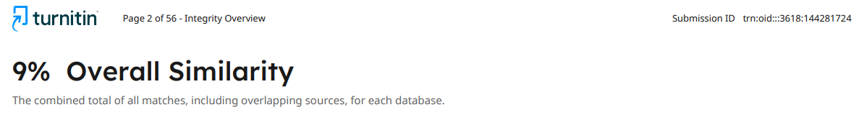
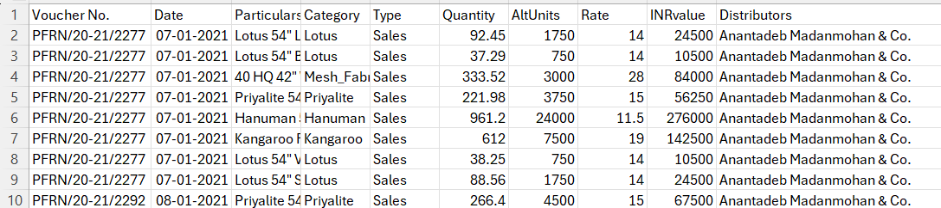
Annexure
Similarity index
Snippet of Data

Slide 18
GitHub Link
https://github.com/Shyamsundarkanaka/LLM-Powered-Agentic-Dashboard-for-Business-Intelligence

